Slide 1
Describing more conversions with ratio
Understanding multiplicative relationships: fractions and ratio

Slide 2
how to use Oak lessons

Slide 3
I can use ratio to describe conversions.

Slide 4
Variables are in proportion if they have a constant multiplicative relationship.
A ratio shows the relative sizes of 2 or more values and allows you to compare a part with another part in a whole.

Slide 5

Describing more conversions with ratio
Interpreting and using map scales
Converting between units of measure

Slide 6
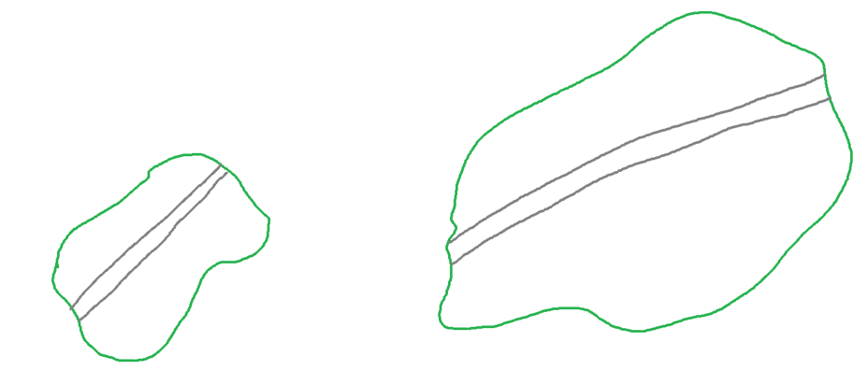
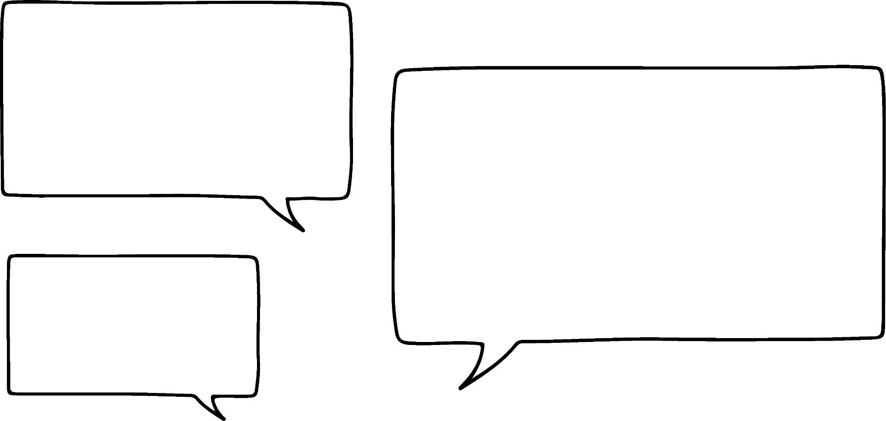
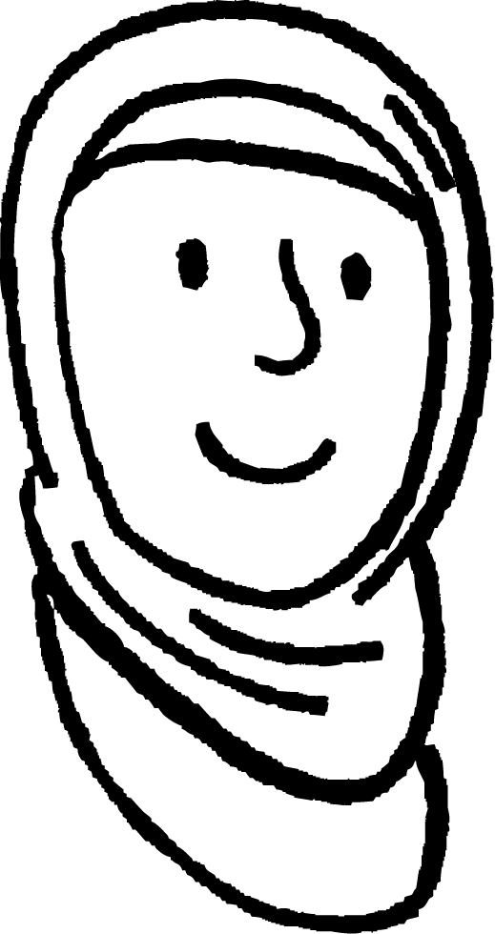

Interpreting and using map scales
Here are the maps of two islands with the main road shown.
Which road is the longest?
Why do you say that?
Well, that is obvious.
We don’t know the scale of the maps.
I’m not sure it is.
Aisha
Alex

Slide 7
Interpreting and using map scales
Scale:
1 cm = 30 km
Scale:
1 cm = 18 km
Maps must have a scale.
If there is no scale, comparisons between them cannot be made.

Slide 8
Interpreting and using map scales
The road on the map for island A is 2.5 cm long and the road on island B is 4 cm long.
Which has the longest road?
Scale:
1 cm = 30 km
Island B
Scale:
1 cm = 18 km
Island A
map (cm) | real (km)
1 | 18
4
map (cm) | real (km)
1 | 30
2.5
map (cm) | real (km)
1 | 18
4 | 72
map (cm) | real (km)
1 | 30
2.5 | 75
× 2.5
× 2.5
× 4
× 4
The road on island A is the longest.

Slide 9

Interpreting and using map scales
A road on a map measures 10 cm long and represents 6000 m.
What is the scale of the map?
map (cm) | real (m)
10 | 6000
1
map (cm) | real (m)
10 | 6000
1 | 600
×
×
The scale is 1 cm : 600 m
Why can’t we just write 1 : 600?
Because the units are different.

Slide 10
Interpreting and using map scales
Often scales do not contain any units.
What would the scale be in the form 1 : without units?
map (cm) | real (m)
1 | 600
m | cm
1 | 100
600
m | cm
1 | 100
600 | 60 000
× 600
× 600
The scale is 1 : 60 000

Slide 11

Interpreting and using map scales
A road on a map is 5 cm long and represents 2500 m.
What is the scale of the map?
m | cm
2500 | 250 000
1 | 100
m | cm
2500
m | cm
2500
1 | 100
The first thing we need to do is work out 2500 m in cm.
× 2500
× 2500
map (cm) | real (cm)
5 | 250 000
1
map (cm) | real (cm)
5 | 250 000
1 | 50 000
We know that 1 m is equivalent to 100 cm.
×
×
The scale is 1 : 50 000

Slide 12
Interpreting and using map scales
Match each of the following to the correct scale:
3 cm = 15 m
6 cm = 3 km
5 cm = 250 m
4 cm = 20 km
1 : 50 000
1 : 5000
1 : 500 000
1 : 500
Unit conversions
1 m = 100 cm
1 km = 1000 m

Slide 13
Interpreting and using map scales
The scale on a map is 1 : 50 000.
The distance between two places on the map is 7 cm.
What is the distance in real life in kilometres?
map | real
1 | 50 000
7
map | real
1 | 50 000
7 | 350 000
× 7
× 7
It is 350 000 cm.

Slide 14
Interpreting and using map scales
What is 350 000 cm in kilometres?
kilo |  |  | metres |  | centi | milli
3 | 5
3 | 5 | 0 | 0 | 0 | 0
describes greater length
describes smaller length
It is 3.5 km.

Slide 15
Interpreting and using map scales
The scale on a map is 1 : 300 000
The distance between two places on the map is 4 cm.
What is the distance in real life in kilometres?
1 | 300 000
4
1 | 300 000
4 | 1 200 000
× 4
× 4
It is 12 km.

Slide 16
Interpreting and using map scales
The scale on a map is 1 : 300 000
The distance between two places on the map is 4 cm.
What is the distance in real life in kilometres?
The scale on a map is 1 : 500 000
The distance between two places on the map is 3 cm.
What is the distance in real life in kilometres?
1 | 300 000
4
1 | 300 000
4 | 1 200 000
1 | 500 000
3
1 | 500 000
3 | 1 500 000
× 4
× 4
× 3
× 3
It is 12 km.
It is 15 km.

Slide 17
Interpreting and using map scales
The scale on a map is 1 : 50 000
The distance between two places is 5.3 km.
What is the distance on the map?
Firstly we need to convert 5.3 km into centimetres.
kilo |  |  | metres |  | centi | milli
5 | 3
5 | 3 | 0 | 0 | 0 | 0
describes greater length
describes smaller length
It is 530 000 cm.

Slide 18
Interpreting and using map scales
The scale on a map is 1 : 50 000
The distance between two places is 5.3 km.
What is the distance on the map?
map | real
1 | 50 000
 | 530 000
map | real
1 | 50 000
10.6 | 530 000
× 10.6
× 10.6
It will be 10.6 cm on the map.

Slide 19
Interpreting and using map scales
The scale on a map is 1 : 300 000
The distance between two places in real life is 4.5 km.
What is the distance between them on the map?
1 | 300 000
 | 450 000
1 | 300 000
1.5 | 450 000
× 1.5
× 1.5
It is 1.5 cm.

Slide 20
Interpreting and using map scales
The scale on a map is 1 : 300 000
The distance between two places in real life is 4.5 km.
What is the distance between them on the map?
The scale on a map is 1 : 300 000
The distance between two places in real life is 7.2 km.
What is the distance between them on the map?
1 | 300 000
 | 450 000
1 | 300 000
1.5 | 450 000
× 1.5
× 1.5
1 | 300 000
 | 720 000
1 | 300 000
2.4 | 720 000
× 2.4
× 2.4
It is 1.5 cm.
It is 2.4 cm.

Slide 21
Interpreting and using map scales
Complete the missing information in each row.
Scale | Map | Real
1 : 250 000 | 6 cm | ___km
 | 15 cm | 300 m
1 : 40 000 |  | 20 km
1 : 3000 | 6 cm | ___m
 | 4 cm | 12 km
1 : 8000 |  | 1200 m
1 : 600 000 |  | 15 km
 | 7 cm | 245 km
1 : 7500 | 5.2 cm | ___km

Slide 22
Interpreting and using map scales
Complete the missing information in each row.
Scale | Map | Real
1 : 250 000 | 6 cm | 15 km
1 : 2000 | 15 cm | 300 m
1 : 40 000 | 50 cm | 20 km
1 : 3000 | 6 cm | 180 m
1 : 300 000 | 4 cm | 12 km
1 : 8000 | 15 cm | 1200 m
1 : 600 000 | 2.5 cm | 15 km
1 : 3 500 000 | 7 cm | 245 km
1 : 7500 | 5.2 cm | 0.39 km

Slide 23
Describing more conversions with ratio
Interpreting and using map scales
Converting between units of measure

Slide 24
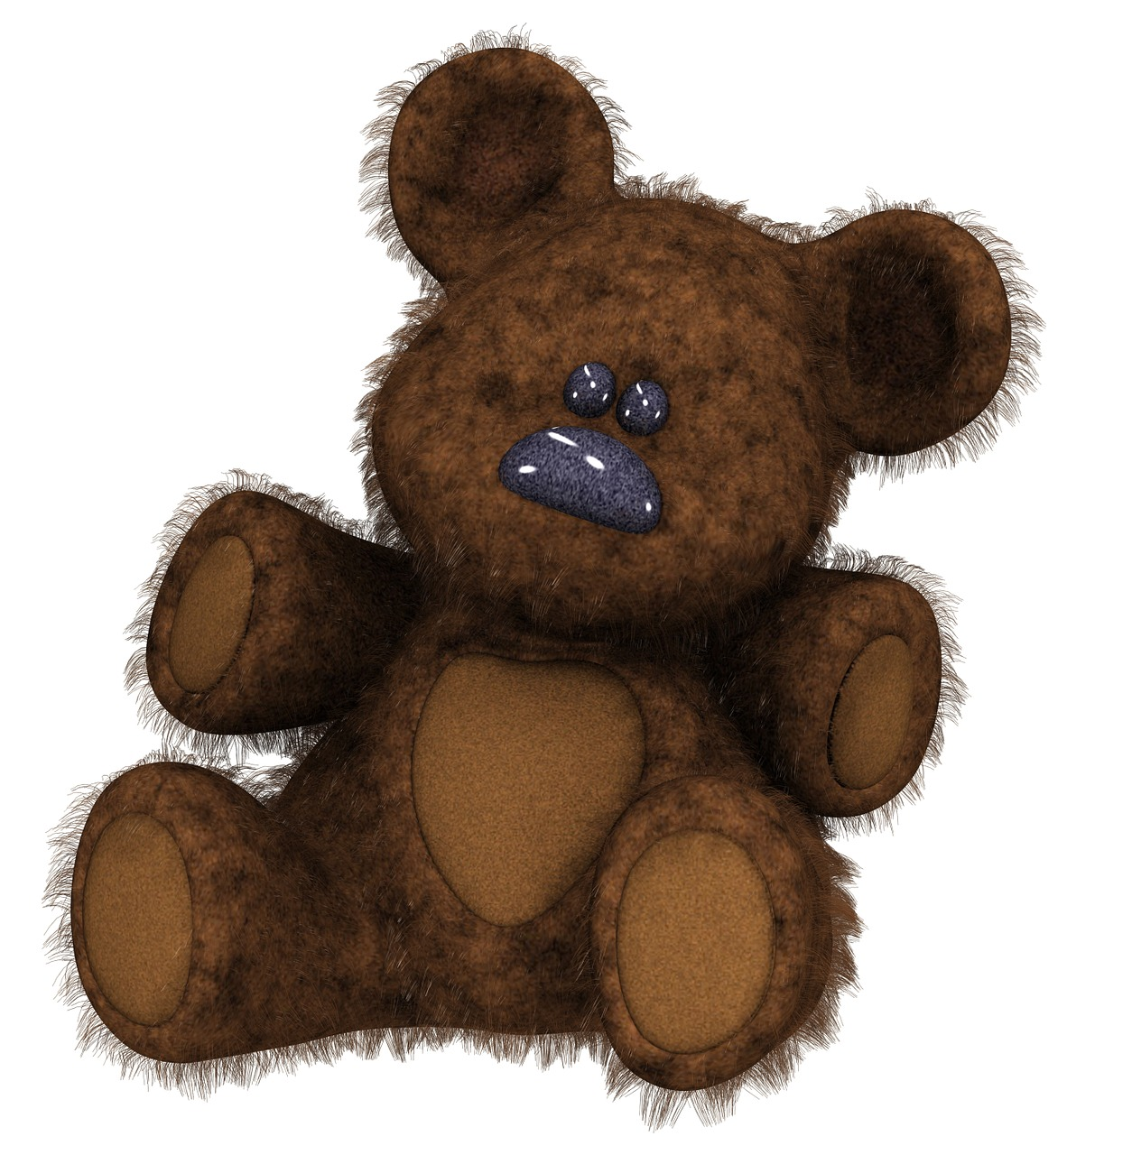
Converting between units of measure
The approximate equivalence of inches and centimetres is:
1 inch = 2.54 cm
Aisha is talking to her dad about his favourite teddy bear when he was little.
He remembers it being 17 inches tall.
Aisha measures her teddy and it is 45 centimetres tall.
Whose teddy is the tallest?
Will it be easier to convert Aisha’s teddy’s height or her dad’s?
As the equivalence uses 1 inch it will be easier to convert her dad’s from inches into centimetres.

Slide 25
Converting between units of measure
inches | centimetres
1 | 2.54
17
inches | centimetres
1 | 2.54
17 | 43.18
× 17
× 17
Aisha’s dad’s teddy was 43.18 cm.
Aisha’s teddy is 45 cm.
So, Aisha’s teddy was taller.

Slide 26
Converting between units of measure
I know that the distance between two villages is 5 miles and this is equivalent to 8 kilometres.
The distance between Lands End and John ‘o Groats as the crow flies is 601 miles.
How far is this in kilometres?
I’ll have to work out how far one mile is so I can convert this.
Do you agree with Alex?
You could but you don’t have to.
Alex

Slide 27
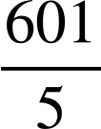
Converting between units of measure
The distance between Lands End and John ‘o Groats as the crow flies is 601 miles.
How far is this in kilometres?
miles | kilometres
5 | 8
601
miles | kilometres
5 | 8
601 | 961.6
×
×

Slide 28
Converting between units of measure
Aisha and Alex completed a bike ride at the weekend.
I rode 4 miles.
I rode 6 kilometres.
Alex
Aisha
Who rode the furthest?
Aisha rode the furthest.
miles | kilometres
5 | 8
4
miles | kilometres
5 | 8
4 | 6.4
× 0.8
× 0.8

Slide 29
Converting between units of measure
If 2 things have a multiplicative relationship, you can find any pair of equivalent values.
‘Zings’ and ‘Zangs’ have a multiplicative relationship.
What is the missing number of ‘zangs’?
Zing | Zang
3 | 18
20
Zing | Zang
3 | 18
20 | 120
× 6
The multiplier for 3 to 20 is a fraction.
Yes, of course we can.
But the multiplier from 3 to 18 is an integer. Can we use the multiplicative relationship between the ‘zings’ and ‘zangs’?
Aisha
Alex

Slide 30
Converting between units of measure
In each of the following ratio tables decide if it is easier to use the multiplicative relationship horizontally or vertically:
5 | 15
28
6 | 5
36
8 | 9
 | 45
4 | 440
57
12 | 96
5
3 | 27
33

Slide 31
Converting between units of measure
Find the missing value:
Find the missing value:
× 120
5 | 600
32
5 | 600
32 | 3840
7 | 12
 | 48
7 | 12
28 | 48
× 4

Slide 32
Converting between units of measure
Find the missing value in each of the following:
5 | 15
28
6 | 5
36
8 | 9
 | 45
4 | 440
57
12 | 96
5
3 | 27
33

Slide 33
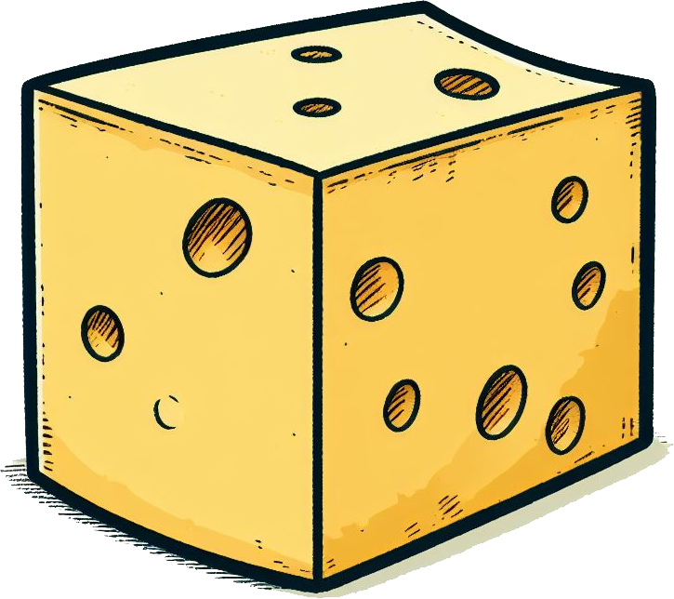

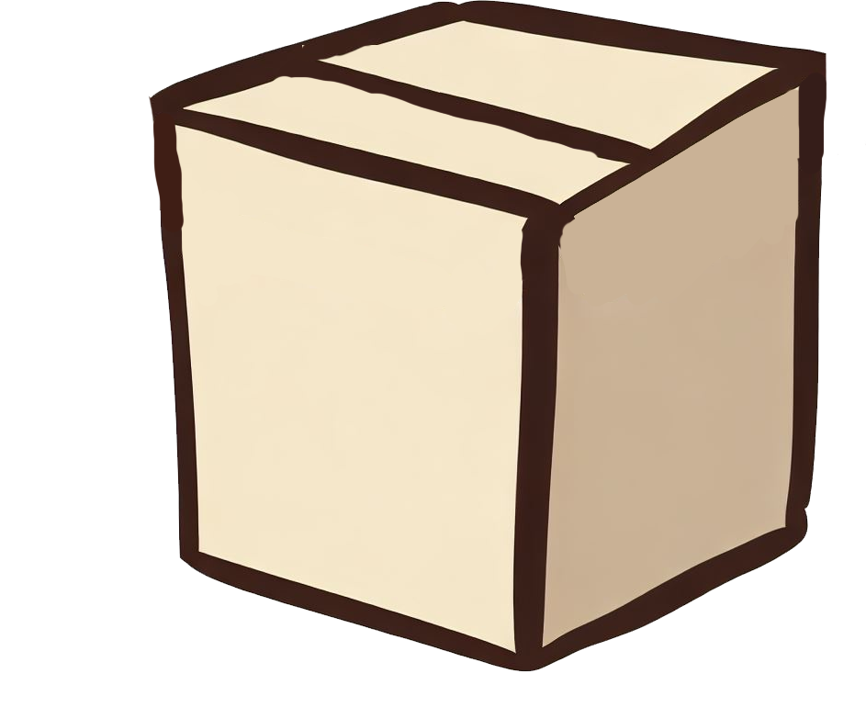
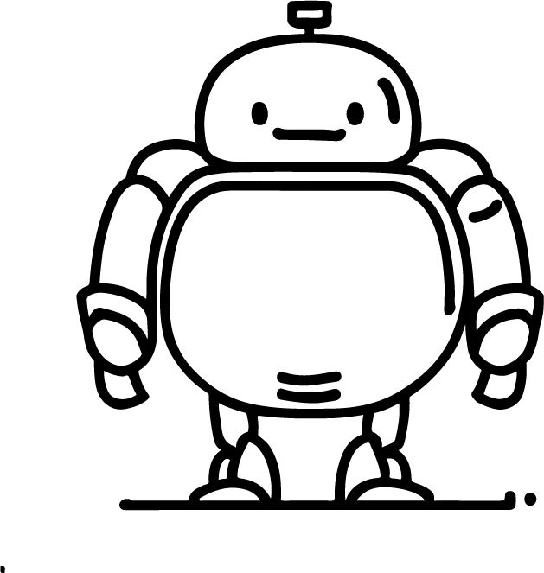



Converting between units of measure
2) Write the following in order from the lightest to the heaviest. Use the conversion 1 kg = 2.2 pounds.
Images are not to scale.
2.3 kg
4.18 pounds
4.62 pounds
2.05 kg
3) Write the following in order from the shortest to the tallest. Use the conversion 1 inch = 2.54 cm.
9.5 inches
20.32 cm
8.5 inches
22.86 cm

Slide 34
Converting between units of measure
4) Write the following in order from the closest to the furthest from this sign. Use the conversion 5 miles = 8 km.
14.6 km TOWN A
TOWN C 15.1 km
9 miles TOWN B
TOWN D 9.25 miles

Slide 35
Converting between units of measure
Find the missing value in each of the following:
5 | 15
28 | 84
6 | 5
36 | 30
8 | 9
40 | 45
4 | 440
57 | 6270
12 | 96
5 | 40
3 | 27
33 | 297

Slide 36
Converting between units of measure
2) Write the following in order from the lightest to the heaviest. Use the conversion 1 kg = 2.2 pounds.
Images are not to scale
2.3 kg
4.18 pounds
4.62 pounds
2.05 kg
Correct order: cheese, sack, brick, box
3) Write the following in order from the shortest to the tallest. Use the conversion 1 inch = 2.54 cm.
9.5 inches
20.32 cm
8.5 inches
22.86 cm
Correct order: feather, teddy bear, flower, robot

Slide 37
Converting between units of measure
4) Write the following in order from the closest to the furthest from this sign. Use the conversion 5 miles = 8 km.
14.6 km TOWN A
TOWN C 15.1 km
9 miles TOWN B
TOWN D 9.25 miles
Correct order: Town B, Town A, Town D, Town C

Slide 38
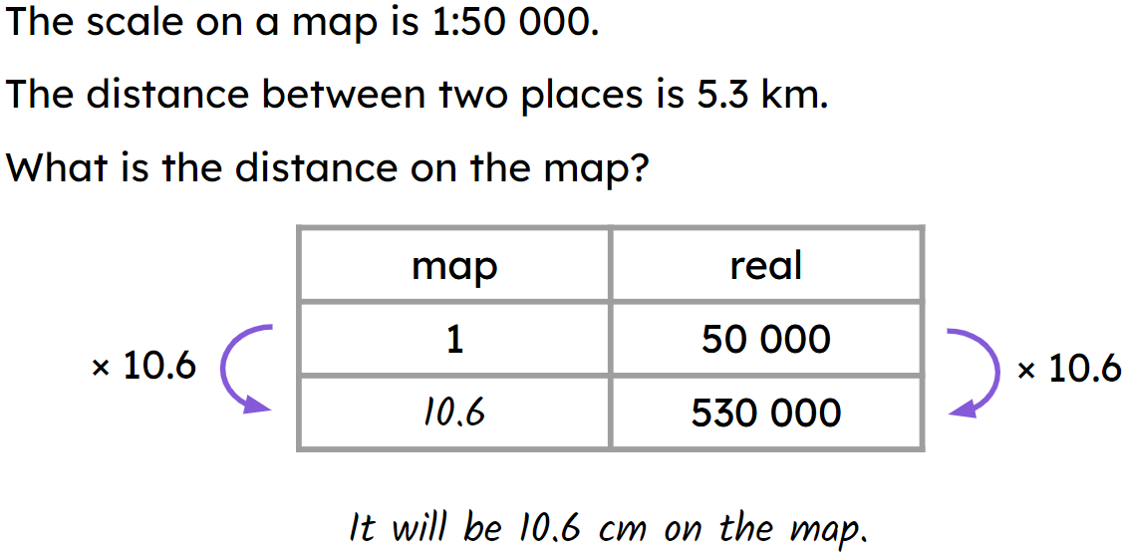
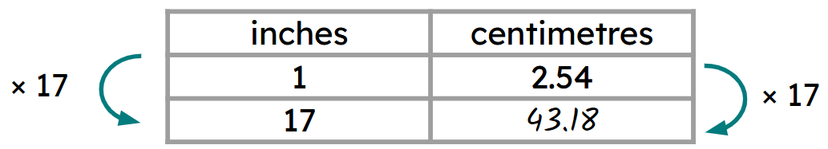
Describing more conversions with ratio
Map scales can be represented with a scale including units.
E.g. 1 cm = 18 km
More commonly the scales are represented as a ratio with no units.
E.g. 1 : 60 000
A ratio table is a useful way to convert between scales.
E.g.
A ratio table can be used when converting other units.
E.g.

Slide 39

© Oak National Academy 2023.
Produced in partnership with Mathematics in Education and Industry.
Licensed on the Open Government Licence v3.0, except where otherwise stated. See Oak terms and conditions.

